Slide 1

外研新标准
第八册 选修8

Slide 2
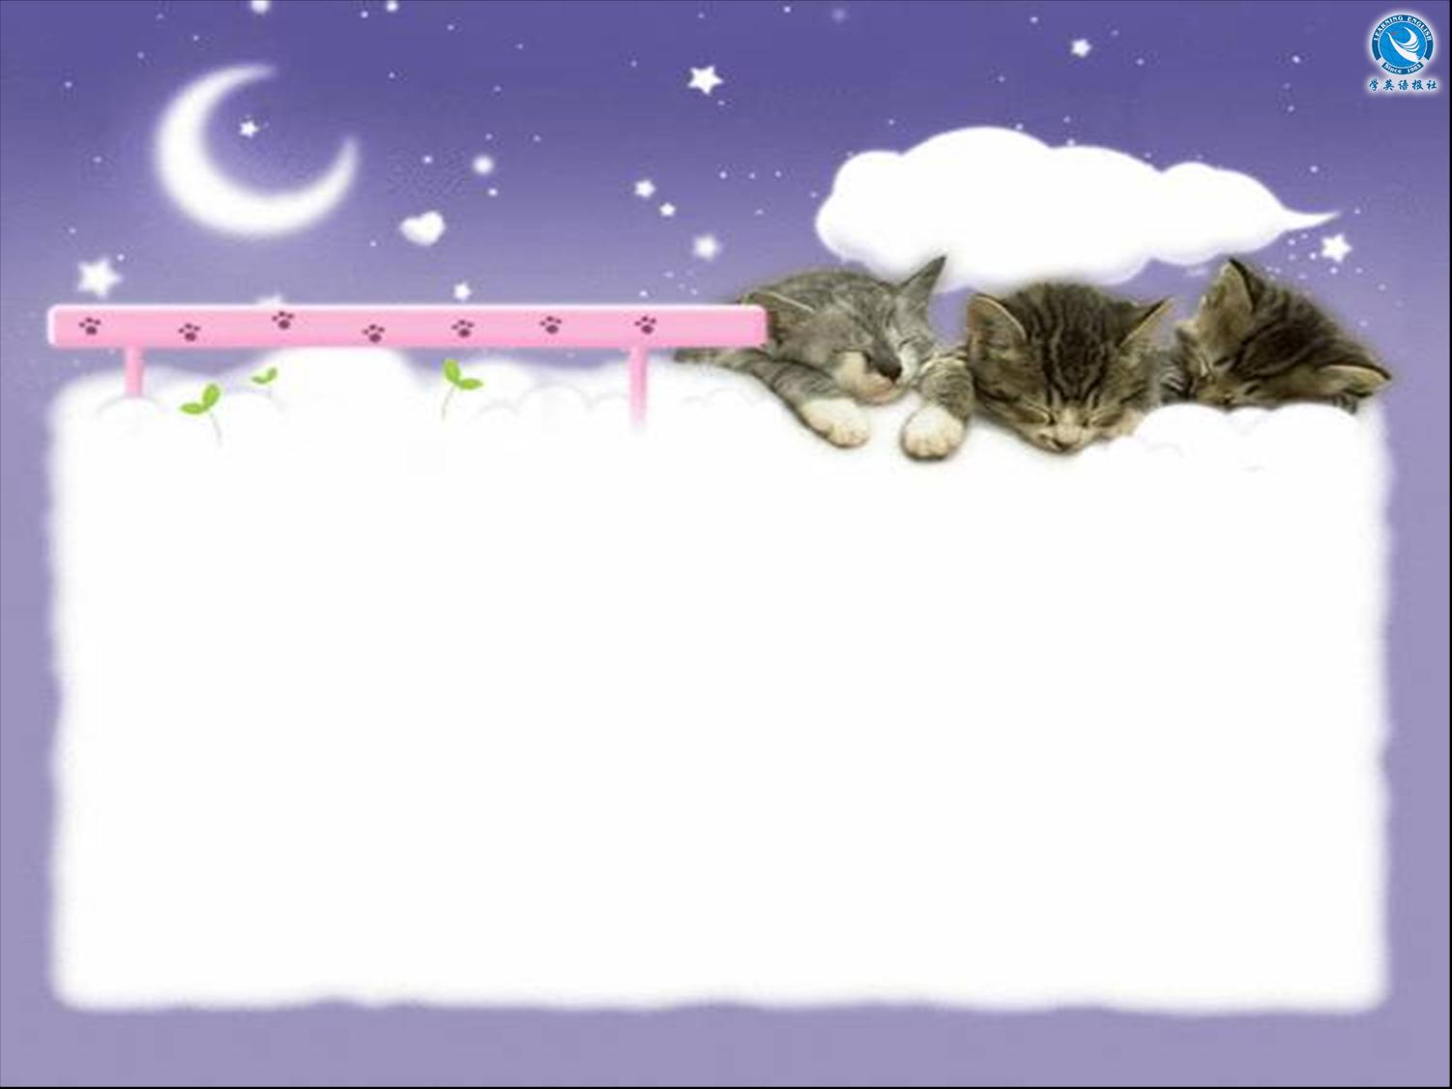

Module 1
Listening

Slide 3


Objective
能识别听力中新学的词汇、短语并正确理解其含义。能听懂对话中主要内容并提取信息。

Slide 4


Listen to the radio programme.

Slide 5


Listen again and fill in the blanks.
(INT = Interviewer MAR = Martin)
INT: Good afternoon and welcome to
History in the Family. Our first _____
today is Martin Richardson, who's going
to tell us about one of the most ______
journeys of the last century — the
_______ to the South Pole of the
Endurance. Good afternoon, Martin.
MAR: Good afternoon.
guest
heroic
voyage

Slide 6
aim
INT: The ___ of the journey was to ______
the continent of Antarctica from east to
west, a ________ of 1,800 miles. And
someone in your family, Martin, ___ ___
that journey. Who was __?
MAR: It was my grandfather.
INT: When did they leave?
MAR: They left on August 8th, 1914 —
which was the same week the First World
War ______ ___.
cross
distance
was on
it
broke out

Slide 7
INT: I see. Tell us about your grandfather.
What was his job? Shackleton took all
_____ __ ______ with him, I believe —
doctors, cooks, a photographer, an artist,
even ...
MAR: My grandfather was a ship's
________.
INT: How old was he?
MAR: He was a young man in his
twenties, he _____ ____ _____ about 27, I
think ...
sorts of people
engineer
must have been

Slide 8
INT: Was he married?
MAR: No, he wasn't. He got married after
he _____ _____.
INT: What part of the country did he come
from?
MAR: At the time he was living in
Southampton, and had been working on
ships on the Transatlantic ________,
between Southampton and New York, but
he came from London ________.
INT: Did you know your grandfather?
came back
crossing
originally

Slide 9
MAR: I don't know, and ___ do they.
They had to boil animal bones to have
something to eat. But he said the men
never ____ ___ hope. Every night they
used to _____ _____ _____ ___ by singing
songs.
INT: Have you ever been to the South
Pole ________?
MAR: No, I haven't. But I hope I will go
one day. I want to ____ ___ _______ to see
Elephant Island.
nor
gave up
keep their spirits up
yourself
take my children

Slide 10
MAR: Oh yes, I remember him _____ ____.
He died when I was about 12.
INT: So you ____ _________ ___ him?
MAR: Oh yes. I was very ____ __ him.
When I was a boy I ____ ___ love listening
to the stories he told me. He was one of the
men ___ ______ on Elephant Island.
INT: How did they _______?
quite well
have memories of
fond of
used to
left behind
survive

Slide 11
INT: One final question. Do you know why
he replied to the advertisement? _ _____,
it was a dangerous job, and there was a
chance that he _____ _____ return home.
MAR: Well, it certainly wasn't to become
rich or famous. It was the sense of
__________. I think he liked the idea of the
risk. Well, I understand him. I like
______ ____, too. I suppose it runs in the
______.
I mean
might never
adventure
taking risks
family

Slide 12

Thank you.

